Slide 1
Comparing Two Variances

Slide 2

Comparing Two Variances
F-Test
Purpose: To test a claim comparing the variances of two independent populations where the null hypothesis is of the form H₀: ${σ_{1}}^{2}={σ_{2}}^{2}$. The test statistic is

Slide 3
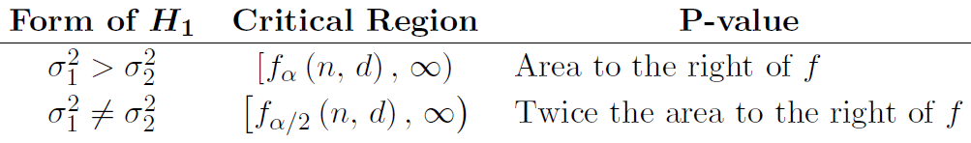
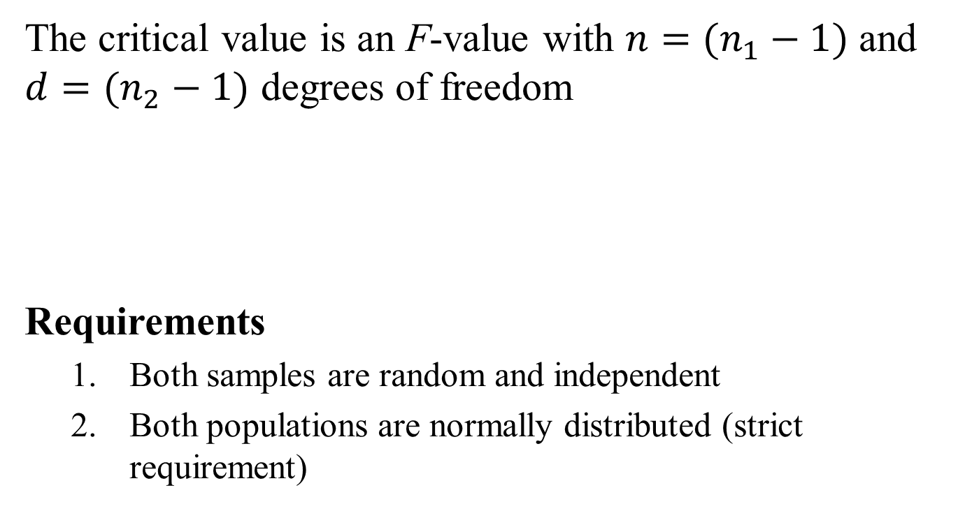
F-Test
The critical value is an F-value with $n=(n_{1}−1)$ and $d=(n_{2}−1)$ degrees of freedom
Requirements
Both samples are random and independent
Both populations are normally distributed (strict requirement)

Slide 4
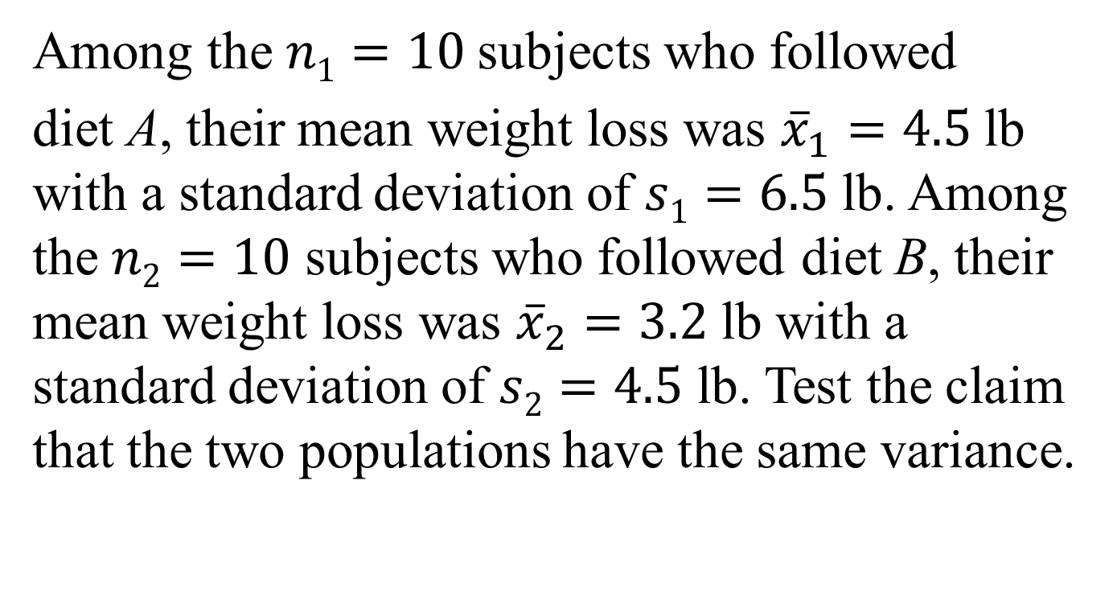
Example
Among the $n1=10$subjects who followed
diet A, their mean weight loss was ${\overline{x}}_{1}=4.5$lb with a standard deviation of $s1=6.5$lb. Among the $n2=10$ subjects who followed diet B, their mean weight loss was ${\overline{x}}_{2}=3.2$lb with a standard deviation of $s2=4.5$ lb. Test the claim that the two populations have the same variance.

Slide 5
Example
The parameters about which the claim is made are
Test statistic:

Slide 6
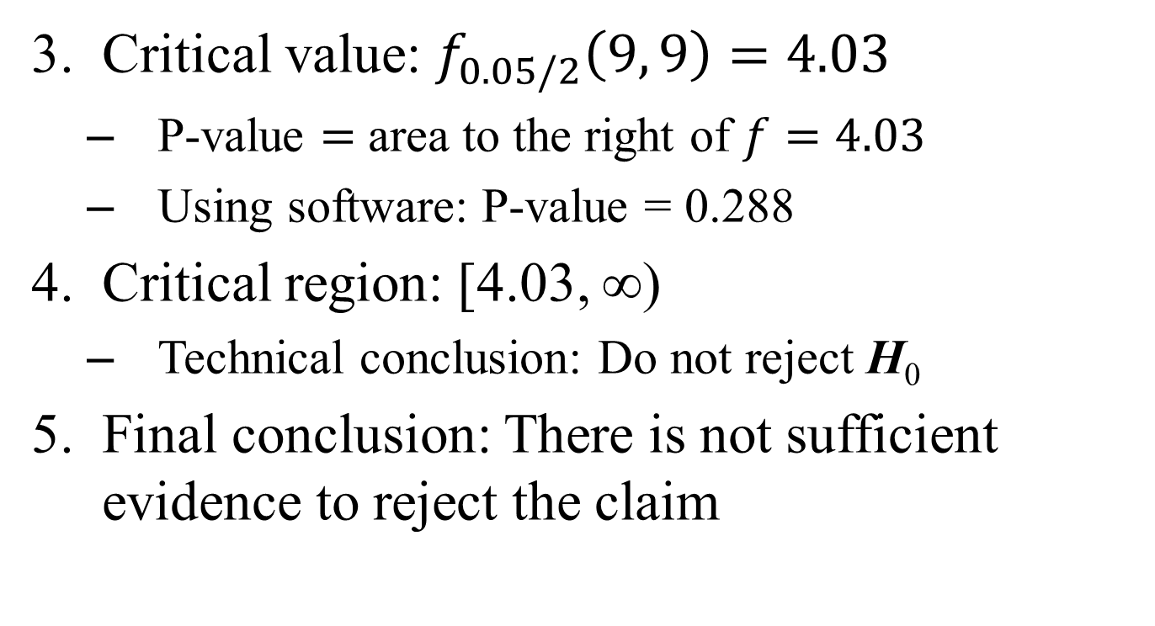
Example
Critical value: $f_{0.05/2}\left(9, 9\right)=4.03$
P-value $=$ area to the right of $f=4.03$
Using software: P-value = 0.288
Critical region: [4.03, ∞)
Technical conclusion: Do not reject H₀
Final conclusion: There is not sufficient evidence to reject the claim

Slide 7
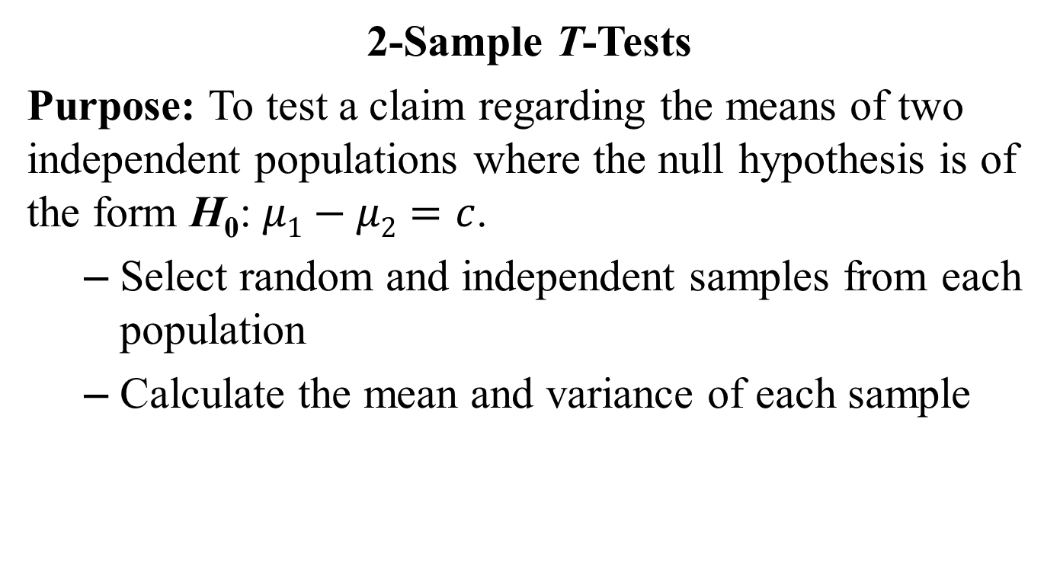
Comparing Two Means
2-Sample T-Tests
Purpose: To test a claim regarding the means of two independent populations where the null hypothesis is of the form H₀: $μ1−μ2=c$.
Select random and independent samples from each population
Calculate the mean and variance of each sample

Slide 8
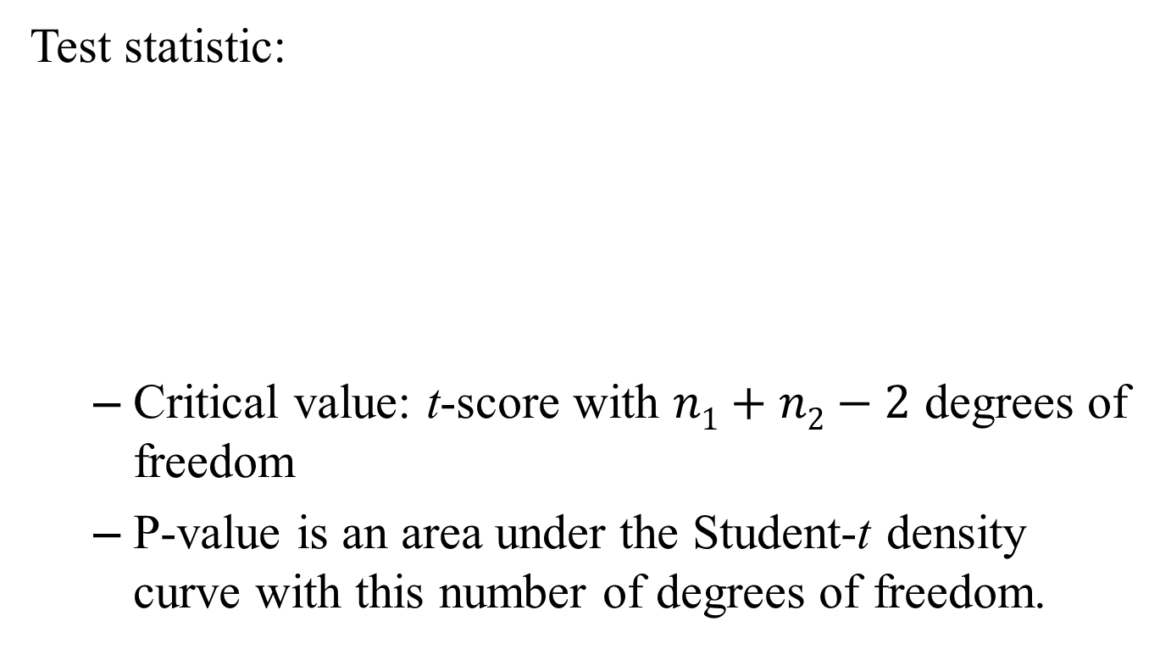
Equal Population Variances
Test statistic:
Critical value: t-score with $n1+n2−2$ degrees of freedom
P-value is an area under the Student-t density curve with this number of degrees of freedom.

Slide 9
Unequal Population Variances
Test statistic:
The critical value is a t-score with r degrees of freedom where r is
If r is not an integer, then round it down to the nearest whole number

Slide 10
Requirements
Both samples are random
The samples are independent
Both populations are normally distributed or both sample sizes are greater than 30

Slide 11
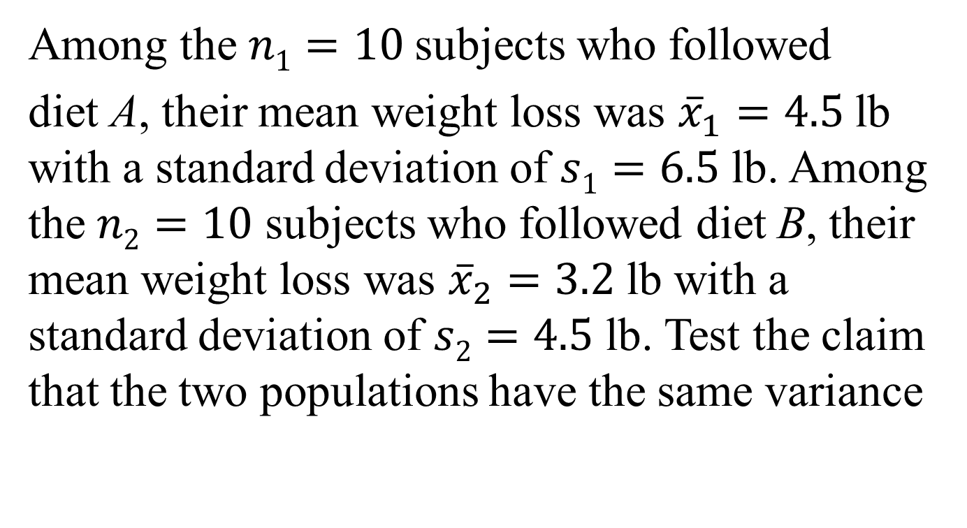
Example
Among the $n1=10$subjects who followed
diet A, their mean weight loss was ${\overline{x}}_{1}=4.5$lb with a standard deviation of $s1=6.5$lb. Among the $n2=10$ subjects who followed diet B, their mean weight loss was ${\overline{x}}_{2}=3.2$lb with a standard deviation of $s2=4.5$ lb. Test the claim that the two populations have the same variance

Slide 12
Example
The parameters about which the claim is made are
Assume equal population variances. Test statistic:

Slide 13
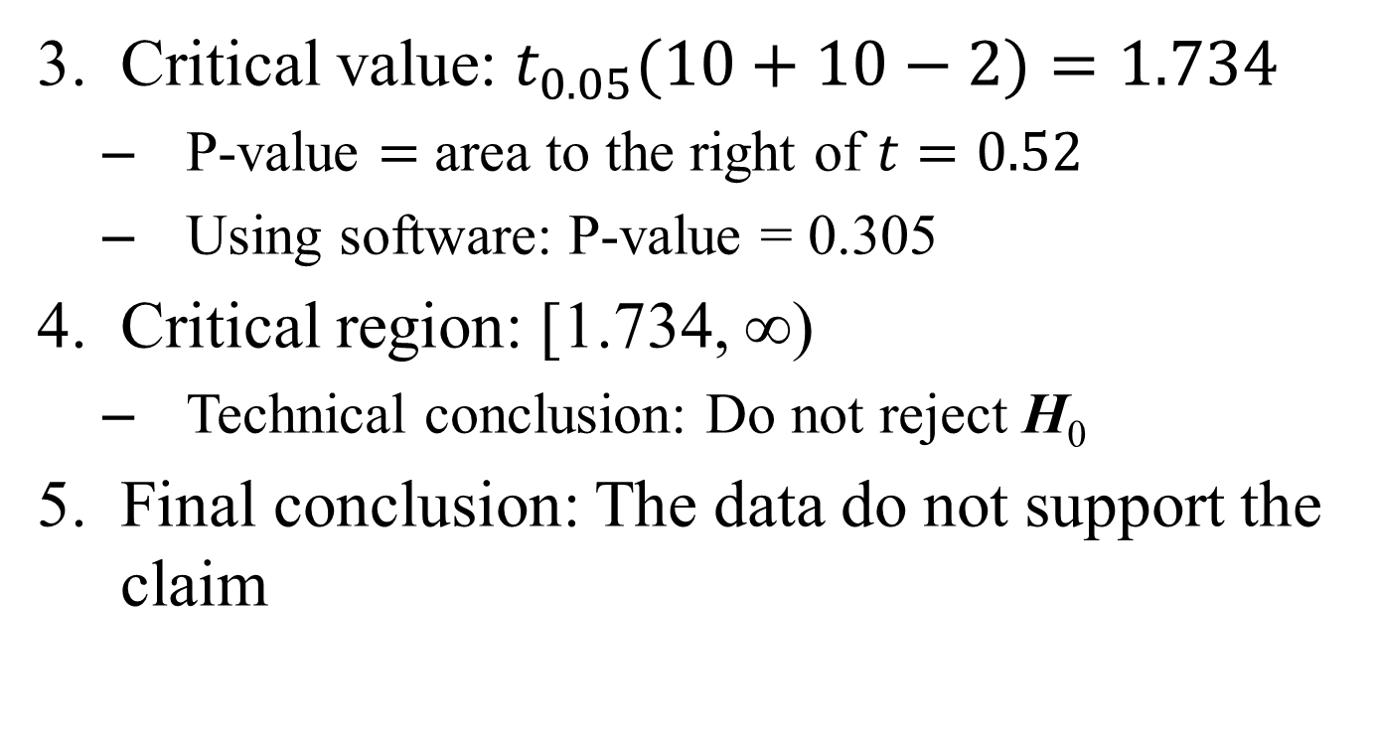
Example
Critical value: $t_{0.05}(10+10−2)=1.734$
P-value $=$ area to the right of $t=0.52$
Using software: P-value = 0.305
Critical region: [1.734, ∞)
Technical conclusion: Do not reject H₀
Final conclusion: The data do not support the claim

Slide 14
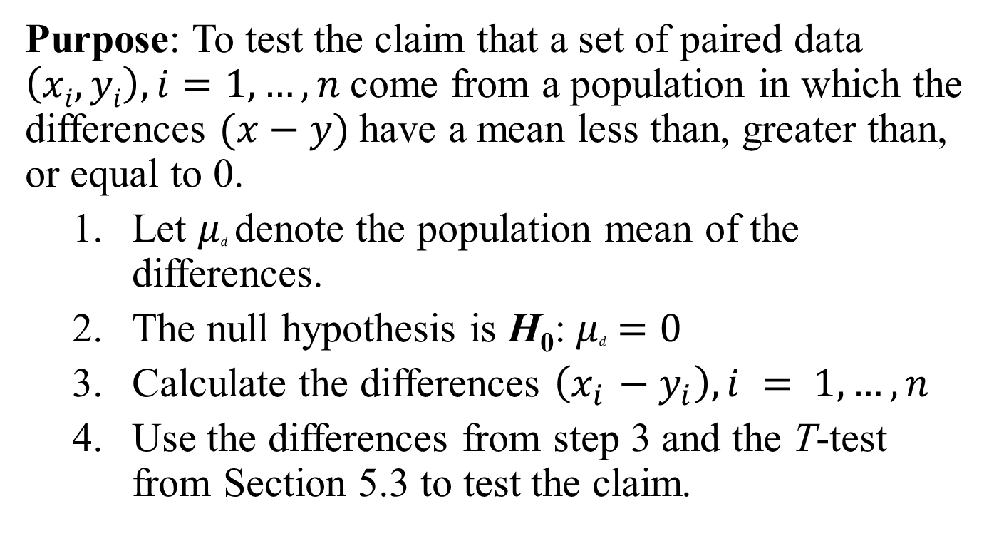
Paired T-Test
Purpose: To test the claim that a set of paired data $\left(xi, yi\right), i=1,…, n$come from a population in which the differences $(x−y)$have a mean less than, greater than, or equal to 0.
Let $μd$denote the population mean of the differences.
The null hypothesis is H₀: $μd =0$
Calculate the differences $\left(x_{i} −y_{i}\right), i = 1,…, n$
Use the differences from step 3 and the T-test from Section 5.3 to test the claim.

Slide 15
Example
At a large university, freshman students are required to take an introduction to writing class. Students are given a survey on their attitudes toward writing at the beginning and end of the class. Each student receives a score between 0 and 100 (the higher the score, the more favorable his or her attitude toward writing). Test the claim that the scores improve from the beginning to the end.

Slide 16
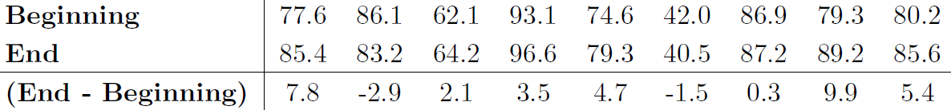
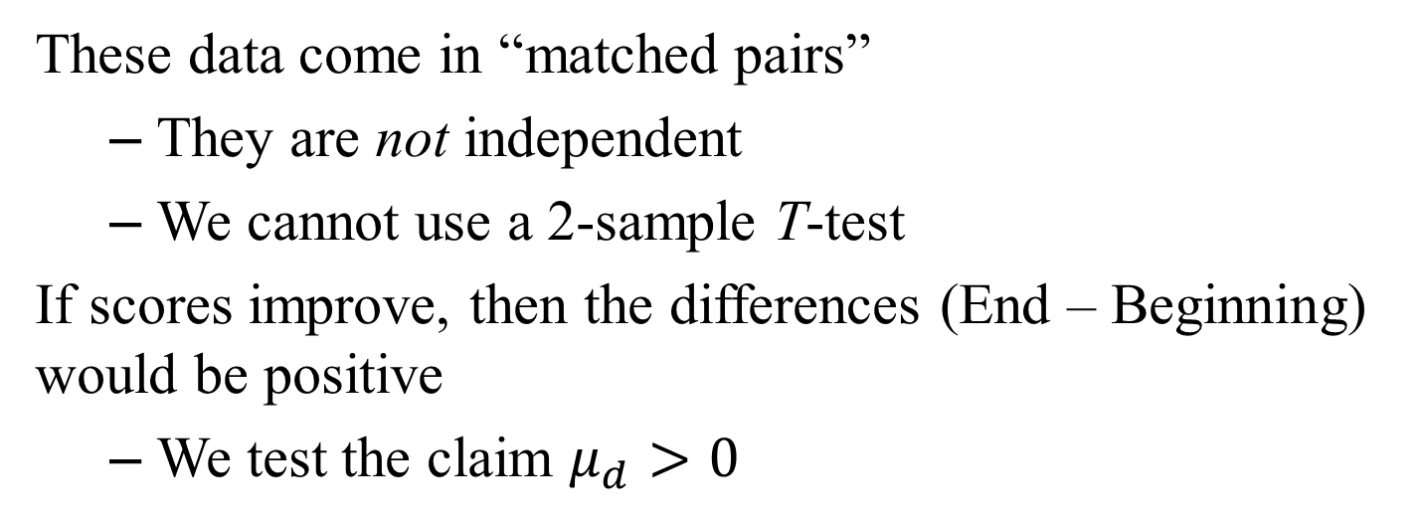
Example
These data come in “matched pairs”
They are not independent
We cannot use a 2-sample T-test
If scores improve, then the differences (End – Beginning) would be positive
We test the claim $μ_{d}>0$

Slide 17
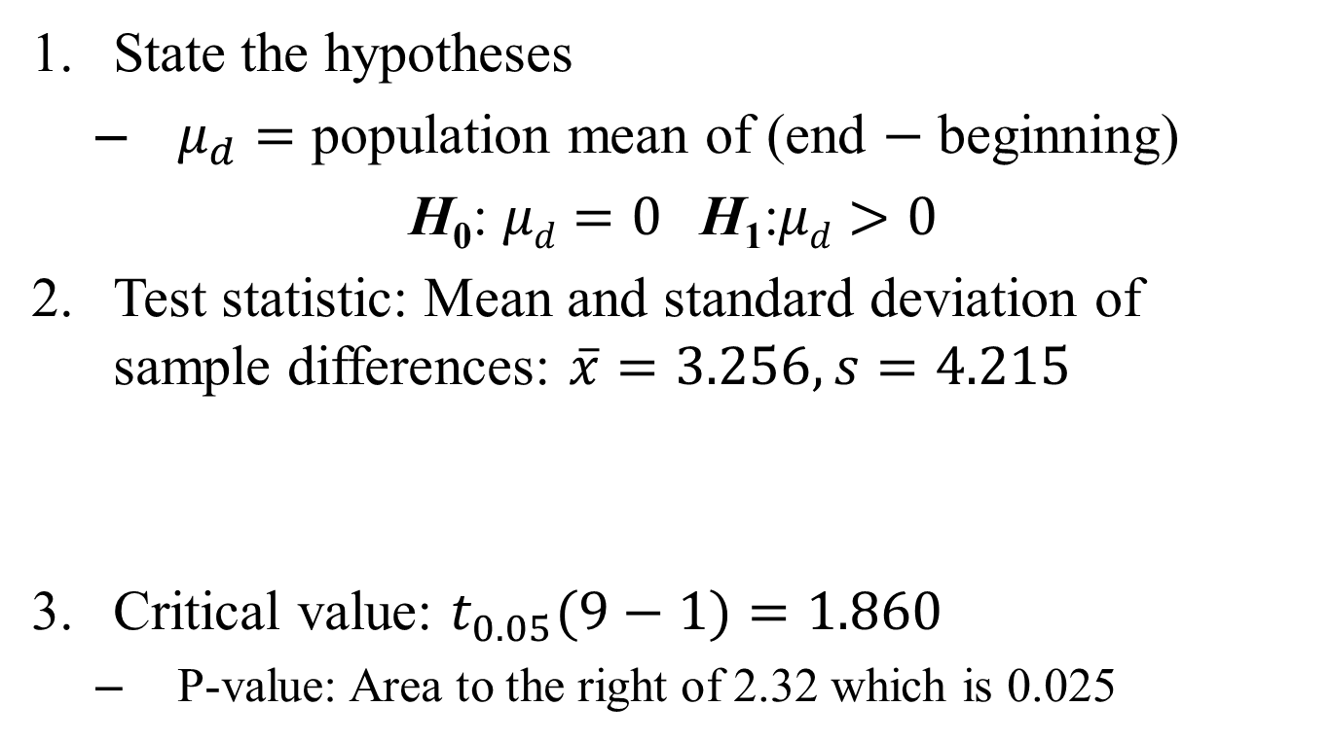
Example
State the hypotheses
$μ_{d}=$ population mean of (end $−$ beginning)
H₀: $μd=0$H₁:$μd>0$
Test statistic: Mean and standard deviation of sample differences: $\overline{x}=3.256, s=4.215$
Critical value: $t_{0.05}(9−1)=1.860$
P-value: Area to the right of 2.32 which is 0.025

Slide 18
Example
Critical region: [1.860, ∞)
Reject H₀
Final conclusion: The data support the claim

